Slide 1
Relation Extraction
A Survey
Yifei Li

Slide 2
Relation Extraction
Occurrences of entities in a sentence are often linked through well-defined relations; e.g., occurrences of person and organization in a sentence may be linked through relations such as employed at.
The task of Relation Extraction (RE) is to identify such relations automatically.

Slide 3
Relation Extraction

Slide 4
Relation Extraction: Challenges
There is a variety of possible relations, which vary from domain-to-domain.
Non-binary relations
Supervised techniques: lack of sufficient training data
Ambiguity
Language-dependent

Slide 5
Datasets
ACE: Automatic Content Extraction
Entity Detection and Tracking (EDT): detecting mentions of these NEs, and identifying their co-references
Relation Detection and Characterization (RDC): detecting relations between entities identified by the EDT task

Slide 6
Global level vs Mention level
Global level RE
To produce a list of entity pairs for which a certain semantic relation exists
Generally takes a large text corpus as input and produces such a list as output
Mention level RE
Takes as input an entity pair as well as the sentence which contains it
Identifies whether a certain relation exists for that entity pair
Also called: Relation Detection and Characterization (RDC).

Slide 7
Outline
Supervised techniques
Feature-based methods
Kernel-based methods (unfinished)
Approaches for joint extraction of entities and relations
Semi-supervised techniques
Unsupervised techniques
Open Information Extraction (Open IE)
Distant supervision based techniques
Recently advanced techniques

Slide 8
Supervised Approaches
Required Labeled Data: each pair of entity, labelled with pre-defined relation types (including: NONE)
Can be considered as a multi-class classification problem
Two kinds of methods:
Feature-based methods
Kernel-based methods

Slide 9
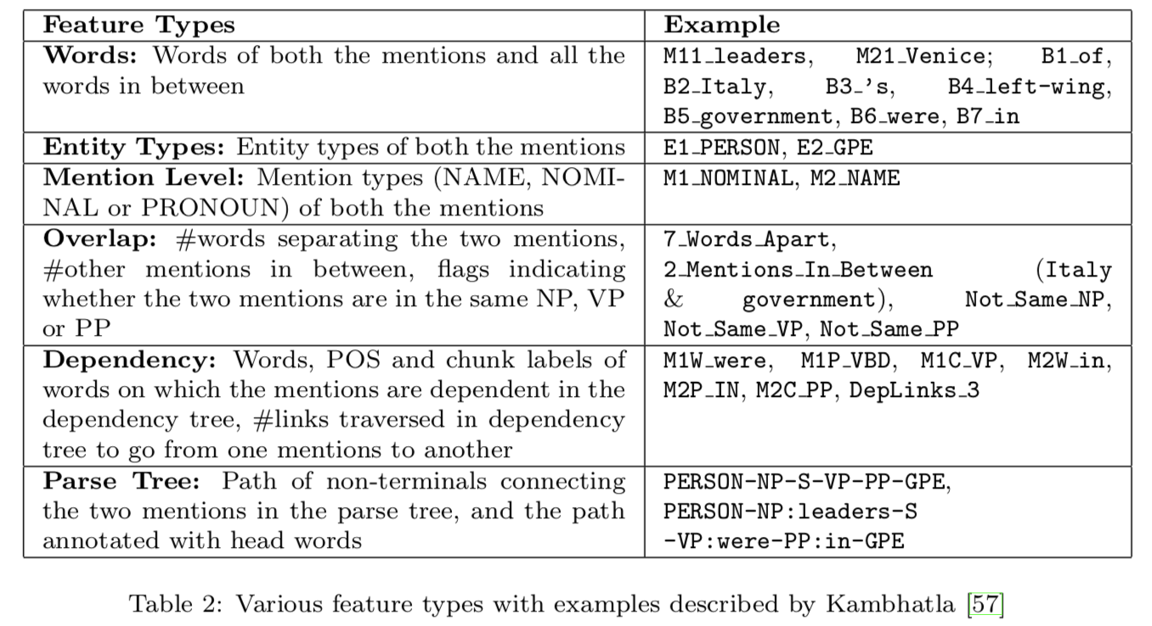
Feature-based Methods
For each relation instance (pair of entity mentions) in the labelled data, a set of features is generated and a classifier is then trained to classify any new relation instance.
Kambhatla et al. trained a maximum entropy classifier with 49 classes
ACE 2003 has 24 relation subtypes, each has 2 classes considering order of relation arguments
a NONE class where two mentions are not related

Slide 10
Improvement
Features:
Word based features
Base phrase chunking based features
Features based on semantic resources
SVM Classifier: one vs others (because SVM is a binary classifier)
Some interesting features blablabla... (没仔细看 -_-||)

Slide 11
Summary for Feature-based Methods
Given relation instance (pair of entity mentions), do feature engineering and classify it into a relation type
Major problem: Class Imbalance --- the number of negative instances (entity pairs with no meaningful relation) outnumber the number of positive instances (entity pairs with one of the pre-defined relation type), which results in a higher precision but lower recall because there are lots of NONE class.
Most of the efforts are spent in designing the "right" set of features, which requires careful analysis of contribution of each feature and knowledge of underlying linguistic phenomena.

Slide 12
Kernel-based Methods
Sequence Kernel
Syntactic Tree Kernel
Dependency Tree Kernel
Dependency Graph Path Kernel
Composite Kernels
这部分由于缺乏kernel function和kernel methods的背景知识，加之时间比较紧张，感觉理解起来比较困难，因此先跳过，以后有时间再补。如果老师/学长学姐能稍微指点一下，起个头，那就更好。

Slide 13
Jointly extract entities and relations
Most of RE techniques: knowledge about boundaries and types of entity mentions are known before hand.
If such knowledge is not available, entity extraction techniques needs to be used first.
Once entity mentions and their entity types are identified, then RE techniques can be applied.
This "pipeline" propagates errors from the first phase to the second phase. To avoid this, a line of research were done to extract entities and relations jointly.

Slide 14
Integer Linear Programming based Approach
First learns independent local classifiers for entity extraction and RE
Given a sentence, produce a global decision that domain-specific or task-specific constraints are satisfied.
To solve the decision consistent with constraints, an Integer Linear Programming (ILP) approach is proposed. It minimizes the cost function including two parts:
Assignment cost: the most probable prediction of a local classifier
Constraint cost: to impose cost for breaking constraints between connected entities and relations
Performance is much better than the simple "pipeline" method

Slide 15
Graphical Models based Approach
The dependencies between entities and relations are encoded through a Bayesian belief network which is a bipartite, directed acyclic graph
Entities are represented as nodes in one layer, whereas relations in another layer
Each relation instance node Rij two incoming edges from its argument entity instance nodes Ei,Ej
Given the feature vector X which characterizes the sentence, the local entity and relation classifiers are used to compute Pr(Ei|X) and Pr(Rij|X), respectively
The constraints are encoded through the conditional probabilities Pr(Rij|Ei,Ej),
Goal:

Slide 16
Card-Pyramid Parsing
Encodes mutual dependencies among the entities and relations in a graph structure
Aim to jointly label the nodes in the card-pyramid graph
The authors propose a parsing algorithm analogous to the bottom-up CYK parsing algorithm for Context Free Grammar (CFG) parsing
Entity Productions of the form EntityT ype → Entity, e.g. PER→leaders. A local entity classifier is trained to compute the probability that entity in the RHS being of the type given in the LHS of the production.
Relation Productions of the form RelationType → EntityType1 EntityType2, e.g. PHYS→PER GPE. A local relation classifier is trained to predict the probability that the relation type in the LHS holds between the two entities in the RHS of the production.

Slide 17
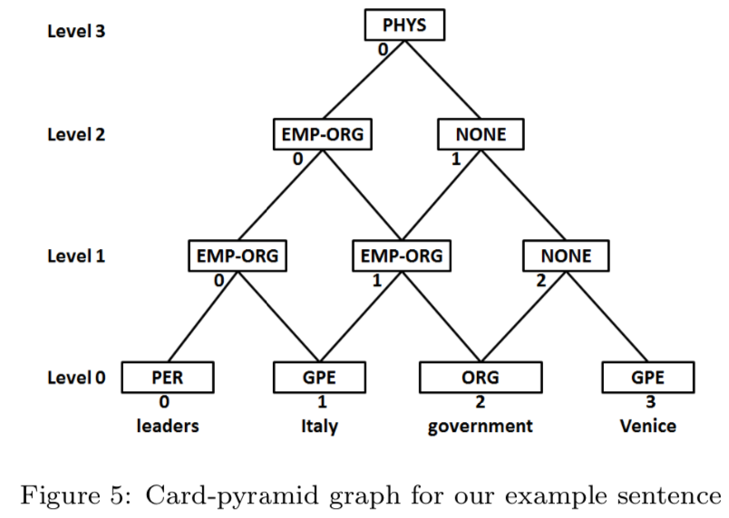
Card-Pyramid Parsing

Slide 18
Semi-supervised techniques
Advantages:
Reduce the manual efforts required to create labelled data
Exploit the unlabeled data which is generally easily available without investing much efforts
Bootstrapping Approaches
Active Learning
Label Propagation Method
Other Methods

Slide 19
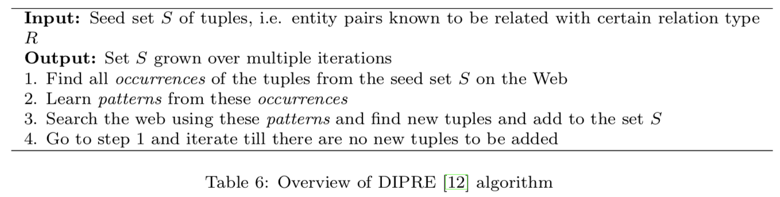
Bootstrapping Approaches
DIPRE (Dual Iterative Pattern Rela- tion Expansion): Pattern Relation Duality
Given a good set of patterns, a good set of tuples (entity pairs following a certain relation type) can be found.
Given a good set of tuples, a good set of patterns can be learned

Slide 20
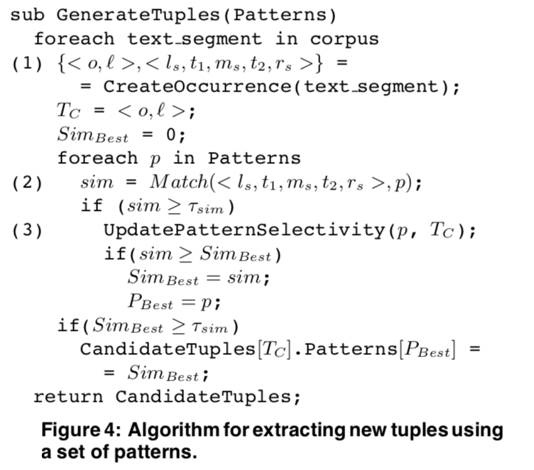
Bootstrapping Approaches - 2
Snowball: an improvement on two points below:
Pattern representation and generation
Evaluation of patterns and tuples

Slide 21
Bootstrapping Approaches - 3
BootProject: SVM, Co-training algorithm
Bootstrapping approaches like DIPRE and SnowBall:
mostly apply relation patterns when both the entities are present as name mentions
NOT good at extracting general relations like EMP-ORG relation in ACE 2004 dataset
Depends on the choice of initial seed examples

Slide 22
Active Learning
To be fulfilled...

Slide 23
Label Propagation Method
The label information for any node is propagated to nearby nodes through weighted edges iteratively and finally the labels of unlabeled examples are inferred when the propagation process is converged
Each entity pair in the dataset is considered as a node in a graph, with a feature vector

Slide 24
Other Methods
Multi-task transfer learning to solve a weakly-supervised RE problem
Condition: only a few seed instances of the relation type of interest are available but a large amount of labelled instances of other relation types is also available
Idea: different relation types can share certain common structures (e.g. EMP-ORG : employees of TCS; GPE-AFF : residents of India).
The proposed framework uses a multi-task transfer learning method along with human guidance in the form of entity type constraints. The commonality among different relation types is modelled through a shared weight vector, enabling the knowledge learned from other relation types to be transferred to the target relation type.

Slide 25
Unsupervised techniques
Advantage: do not require any labelled data
Methods:
Clustering based approaches
Other approaches

Slide 26
Clustering-based approaches
The earliest completely unsupervised RE: only require a NER tagger.
The approach can be described in following steps:
1. The named entities in the text corpora are tagged
2. Co-occurring named entity pairs are formed and their contexts are recorded
3. Context similarities among the pairs identified in the step 2, are computed
4. Using the similarity values computed in previous step, the pairs are clustered
5. As each of these clusters represent one relation, a label is automatically assigned to each cluster describing the relation type represented by it

Slide 27
Non Clustering-based approaches
URES: Unsupervised RE System
Input: the definitions of the relation types of interest
A relation type is defined as a small set of keywords, including relation type and entity types of its arguments. e.g. for the relation type Acquisition, the keywords can be acquired, acquisition
The direct successor of KnowItAll system, which extracts entities
URES: extract relations

Slide 28
Unsupervised paraphrase acquisition for RE
Paraphrases: The text expressions that convey roughly the same meaning.
The approach begins with one text expression (and corresponding syntactic structure like dependencies structure) representing the target relation and finds its paraphrases using an unsupervised paraphrase acquisition approach.
e.g. X interact with Y, paraphrase acquisition algorithm would produce new expressions - X bind to Y, X activate Y, X stimulate Y, interaction between X and Y, etc.

Slide 29
Open Information Extraction (Open IE)
Traditional RE: focuses on precise, pre-specified set of relations
require human involvement to design extraction rules and creating labelled training data
hard to change into different domains
Open IE
Automatically discover possible relations in the text corpus without any human involvement
No additional efforts are required to switch to a different domain
TextRunner system

Slide 30
Self-supervised Learner
Automatically labels a set of extracted entity tuples as positive or negative with some heuristic rules
Here, positive class indicates that the corresponding tuple represents some valid relation
After automatic labelling, each tuple is mapped to a feature vector representation and a Naive Bayes classifier is trained

Slide 31
Single Pass Extractor
Traverse the entire corpus and obtain POS and NP (base noun phrases) information for all sentences
Each pair of NPs (E1 and E2) becomes a candidate tuple
Heuristically decide whether to include words between E1 and E2 in R
Candidate tuples are presented to Naive Bayes classifier, "positive"s are extracted and stored

Slide 32
Redundancy-based Assessor
TextRunner automatically merges tuples with same entities & relations
Number of distinct sentences containing the tuple is recorded, and count a probability of correctness of each tuple

Slide 33
Improvements to TextRunner
Use O-CRF (self supervised Conditional Random Field sequence classifier) instead of Naive Bayes classifier observed better performance
Use Wikipedia infoboxes to more accurately generate training data for the Self-supervised Learner module
Bootstrapping methods like Snowball:
Significantly reduce the number of initial training examples
Do not perform OpenIE (?)
StatSnowball: can perform open IE along with traditional RE

Slide 34
Limitations of TextRunner
Incoherent Extractions: No meaningful interpretation of extracted re- lation phrases can be made
This is caused by a word-by-word decision making about whether to include a word in a relation phrase.
Uninformative Extractions: These extractions omit critical information
Generally caused by improper handling Light Verb Constructions (LVCs) (复合短语).
e.g. "John made a promise to Alice", TextRunner: (John, made, a promise), Correct: (John, made a promise to, Alice)
Overly-specific Extractions: extract very specific relations which are not useful
e.g. The Obama administration, [is offering only modest greenhouse gas reduction targets at], the conference

Slide 35
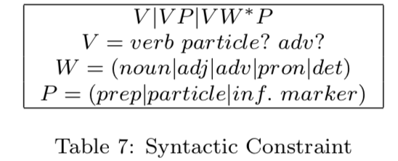
ReVerb: an advanced OpenIE system
This system improves over TextRunner by overcoming following limitations of TextRunner:
Syntactic Constraint: constraint relation phrases to match several POS tag patterns. This avoids both "Incoherent" problem and "Uninformative" problem since LVCs are also captured.

Slide 36
Summary for OpenIE
Recently, Open IE has been an active area of research within RE systems.
Major advantage
Unsupervised nature
Scalability to the Web scale
Limitation
Same semantic relation may be represented by multiple relation phrases

Slide 37
Distant Supervision
Idea: use a large semantic database for automatically obtaining relation type labels
Labels may be noisy, but the huge amount of training data is expected to offset this noise.

Slide 38
Distant Supervision - 2
Advantages of both supervised and unsupervised:
It combines thousands of features using a probabilistic classifier as in the case of supervised paradigm.
It extracts a large number of relations from large corpora of any domain as in the case of unsupervised paradigm.
Shortcomings:
Failed to model overlapping relations, i.e. the same pair of entities with multiple valid relations.
e.g. FoundedBy (Steve Jobs, Apple) and CEO (Steve Jobs, Apple)
Some solutions: Multi-instance Multi-label learning based approach (MIML-RE)

Slide 39
MIML-RE
A novel graphical model is used to represent "multiple instances" as well as "multiple labels" of an entity pair
Mention level relation classifiers
Entity pair level classifiers
Outperforms many traditional distant supervision approaches
Major advantage: the entity pair level classifiers
Details are to be continued...

Slide 40
Distant Supervision - 3
Recently: many new approaches are actively being proposed to overcome specific problems
FALSE negative instances: due to the incompleteness of semantic database
MIML-RE's data likelihood: is a non-convex formulation
Ontological-Smoothing (本体平滑)
Details need to read the cited papers listed by the survey's author.

Slide 41
Recent Advances in Relation Extraction
Universal Schemas
n-ary Relation Extraction
Cross-sentence Relation Extraction
Convolutional Deep Neural Network
Cross-lingual Annotation Projection
Domain Adaptation

Slide 42
Reference
[1] Pawar, Sachin, Girish K. Palshikar, and Pushpak Bhattacharyya. "Relation extraction: A survey." arXiv preprint arXiv:1712.05191 (2017).
[2] Kumar, Shantanu. "A survey of deep learning methods for relation extraction." arXiv preprint arXiv:1705.03645 (2017).
[3] Slide: A-survey-on-Relation-Extraction-Slides. CMU.
[4] Slide: cse517wi13-RelationExtraction. Stanford.

Slide 43
Thanks
Yifei Li

